Slide 1
HACKATHON PROJECT · TEAM 16
AeroSearch: Parallel Multi-Threaded File Search Engine
Native POSIX C Core with Real-Time Worker Telemetry at 127.0.0.1:8000
Lohith Sanapala (2520030023) · Saahas Vaddi (2520030256) · Rapaka Rithwik (2520030427)

Slide 2
TEAM 16 ARCHITECTURE & ROLES
Team 16 Engineered a Full-Stack Native C Search Engine
Lohith Sanapala
ID 2520030023: Systems & Concurrency Lead.
POSIX C Core: Built pthread pool and mutex locks.
Saahas Vaddi
ID 2520030256: File I/O & Pattern Matching Lead.
Search Engine: Built file crawler and ext filters.
Rapaka Rithwik
ID 2520030427: Telemetry & Web Interface Lead.
Dashboard UI: Built 127.0.0.1:8000 UI and exports.
AeroSearch (C Core) · Team 16 · Slide 2 of 12

Slide 3

PROBLEM STATEMENT
Serial Scans Stall Multi-Core Systems
Why Legacy Search Falls Short
Idle CPU Cores: Single-threaded tools leave 15 of 16 logical cores idle during deep scans.
I/O Bottlenecks: Linear traversal across hundreds of .c, .h, .py, and .log files inflates latency.
Opaque Execution: Standard CLI utilities hide per-thread workload, match density, and throughput.
AeroSearch (C Core) · Team 16 · Slide 3 of 12

Slide 4
SYSTEM ARCHITECTURE
Three Decoupled Layers Link POSIX C to Web Telemetry
1. POSIX C Core
Native Binary: Runs on 16-core, 15.7 GB RAM hosts.
Direct File I/O: Zero VM overhead for fast reads.
2. Thread Pool
Worker Pool: Scales across 4+ concurrent threads.
Mutex Safety: pthread_mutex_lock guards queues.
3. Web Bridge
Localhost UI: Hosted at http://127.0.0.1:8000/.
Live Metrics: Streams per-thread telemetry cards.
AeroSearch (C Core) · Team 16 · Slide 4 of 12

Slide 5

CONCURRENCY & SYNCHRONIZATION
Mutex Locks Guard Worker Thread Pools
High-Concurrency POSIX Design
Parallel Dispatch: Directory crawler partitions E:/OSSP-Hackathon across active worker threads.
Critical Sections: Workers bracket shared state updates with pthread_mutex_lock and unlock.
Lock-Free Scanning: Line-by-line pattern matching executes in thread-local memory buffers.
AeroSearch (C Core) · Team 16 · Slide 5 of 12

Slide 6
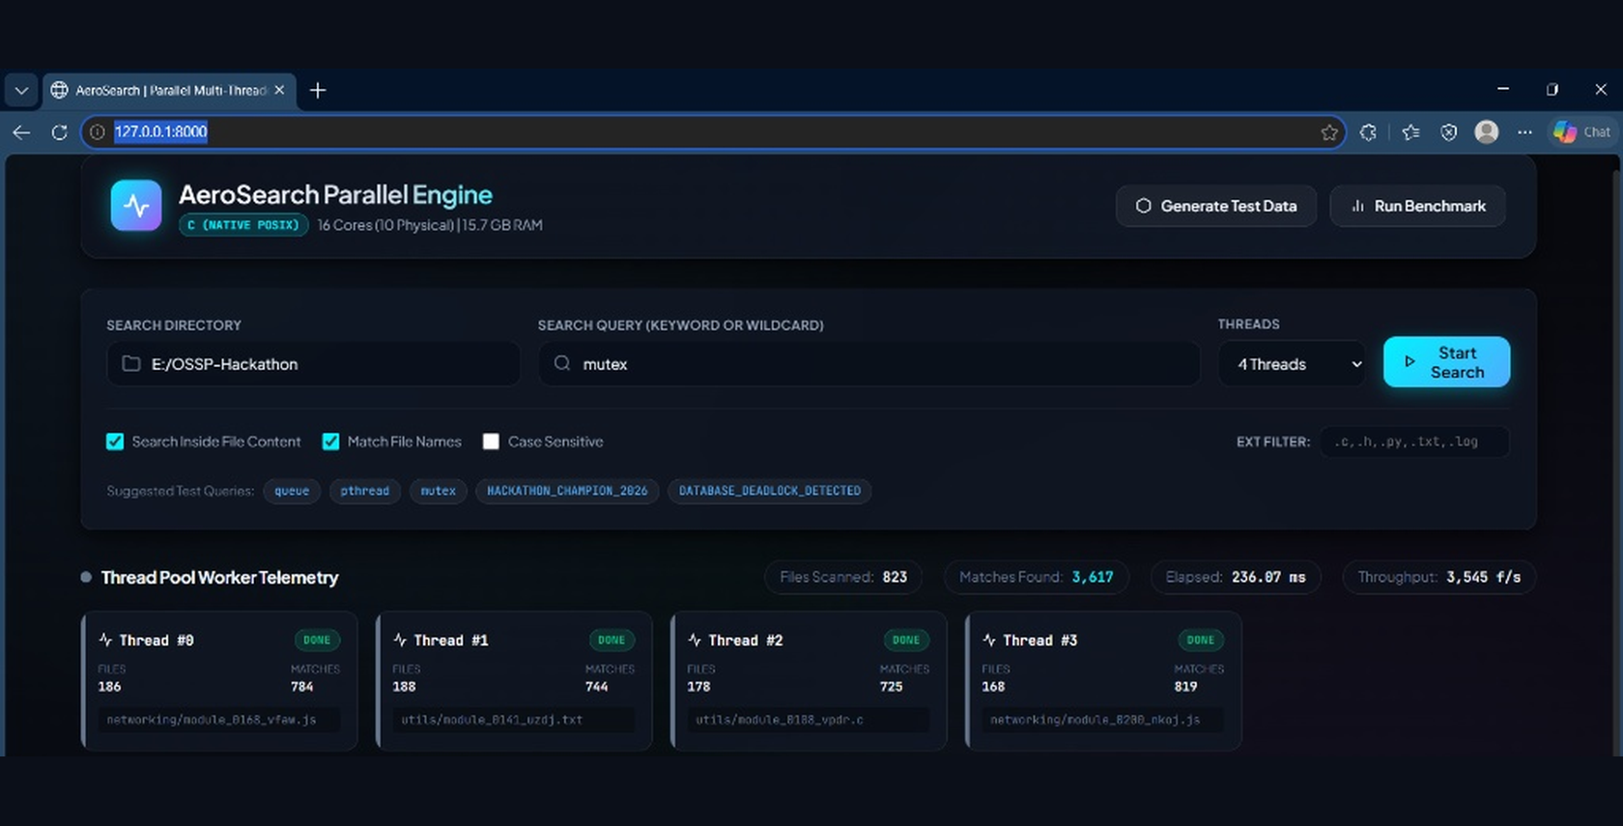
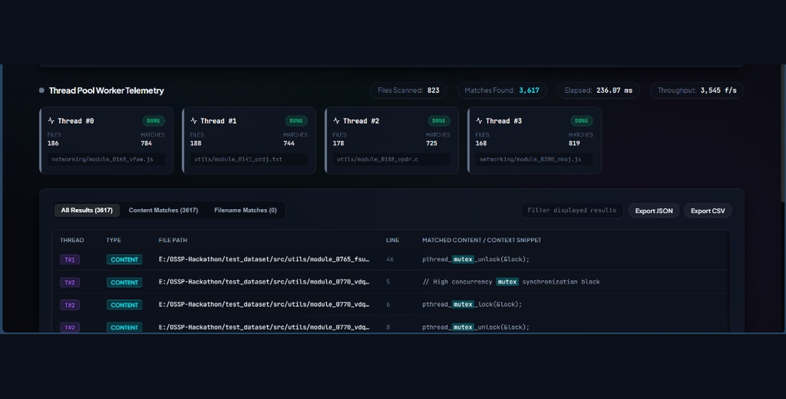
INTERACTIVE DASHBOARD (HTTP://127.0.0.1:8000/)
Web Console Unifies Search Controls and Live Telemetry
Control Bar & Worker Telemetry Cards
Query & Pool Setup: Configures E:/OSSP-Hackathon, keyword mutex, 4 Threads, and live worker status.
Granular Match Stream & Export Bar
Context & Exports: Lists all 3,617 content hits with thread tags, line numbers, and JSON/CSV export.
AeroSearch (C Core) · Team 16 · Slide 6 of 12

Slide 7
THREAD POOL WORKER TELEMETRY
Four Worker Threads Balance 823 Files and 3,617 Matches
Telemetry Breakdown
Even File Split: Workers process 168 to 188 files each across networking and utils modules.
High Hit Capture: Thread #3 leads with 819 matches; Thread #0 follows with 784 matches.
Zero Stragglers: All 4 POSIX threads reach DONE status simultaneously in 236.07 ms.
AeroSearch (C Core) · Team 16 · Slide 7 of 12

Slide 8

SEARCH & FILTERING ENGINE
Smart Filters Target Exact Source Code
Configurable Search Modes
Dual Match Scope: Combines Search Inside File Content, Match File Names, and Case Sensitive toggles.
Extension Filter: Targets .c, .h, .py, .txt, and .log files while scanning JS/C module trees.
Diagnostic Presets: One-click chips test queue, pthread, mutex, and DATABASE_DEADLOCK_DETECTED.
AeroSearch (C Core) · Team 16 · Slide 8 of 12

Slide 9
LIVE RESULT STREAM (QUERY: MUTEX)
Line-Level Context Pinpoints Exact C Synchronization Code
Thread | Type | Dataset File Path | Line | Matched Content / Context Snippet
T#1 | CONTENT | E:/OSSP-Hackathon/test_dataset/src/utils/module_0765_fsu... | 46 | pthread_mutex_unlock(&lock);
T#2 | CONTENT | E:/OSSP-Hackathon/test_dataset/src/utils/module_0770_vdq... | 5 | // High concurrency mutex synchronization block
T#2 | CONTENT | E:/OSSP-Hackathon/test_dataset/src/utils/module_0770_vdq... | 6 | pthread_mutex_lock(&lock);
T#2 | CONTENT | E:/OSSP-Hackathon/test_dataset/src/utils/module_0770_vdq... | 8 | pthread_mutex_unlock(&lock);
AeroSearch (C Core) · Team 16 · Slide 9 of 12

Slide 10
PERFORMANCE BENCHMARKING
AeroSearch Scans 823 Files in 236.07 ms at 3,545 Files/Sec
Verified Benchmark Metrics
236.07 ms Latency: Completes full content scan of 823 files and 3,617 matches in under a quarter-second.
3,545 f/s Throughput: Sustains high-speed file ingestion across 4 concurrent POSIX threads.
4.39 Matches / File: Identifies dense synchronization patterns across C and JS test modules.
AeroSearch (C Core) · Team 16 · Slide 10 of 12

Slide 11
WORKFLOW INTEGRATION & IMPACT
Built-In Stress Generators and Exports Streamline Audits
Test Generator
Synthetic Trees: Builds src/utils and networking folders.
Stress Loads: Generates C, JS, and TXT test files.
Benchmarking
Live Timing: Measures wall-clock latency in ms.
Pool Scaling: Tests 4 threads on 16-core hardware.
Data Exports
Instant Filter: Narrows 3,617 displayed hits live.
JSON & CSV: One-click export for CI/CD audits.
AeroSearch (C Core) · Team 16 · Slide 11 of 12

Slide 12
AEROSEARCH PARALLEL ENGINE · TEAM 16
Thank You — Questions & Live Demo
Native POSIX Multi-Threading at 3,545 Files/Second
Lohith Sanapala (2520030023) · Saahas Vaddi (2520030256) · Rapaka Rithwik (2520030427)

